Slide 1

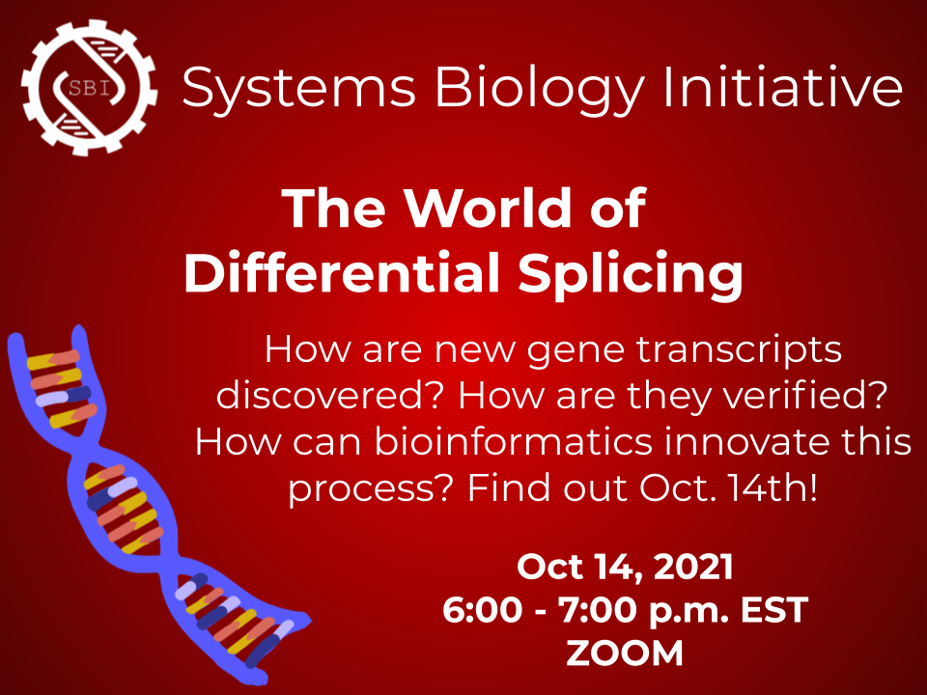
Systems Biology Initiative
The World of
Differential Splicing
Presented by Theo Nelson

Slide 2
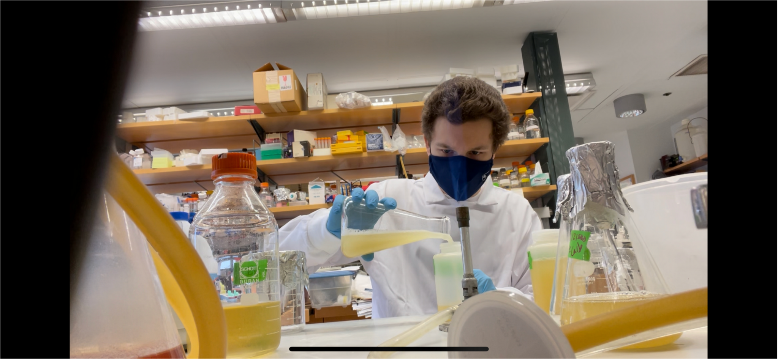
Introductions
Theo Nelson
tmn2126@columbia.edu
CC ‘24
Computer Science / PreMed
Dry and Wet Lab Research Experience
Systems Biology Initiative
sbi.columbia@gmail.com
Student Organization
Systems Biology - Computational Biology
https://sbicolumbia.wixsite.com/cusbi
Send a wave to a fellow listener!

Slide 3

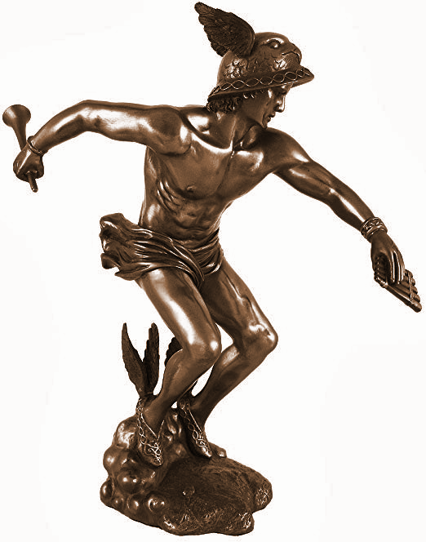

Core Concepts
Variability
DNA
RNA
Protein

Slide 4
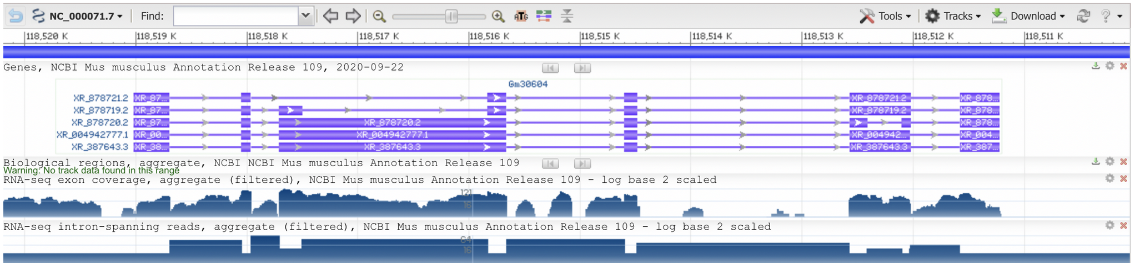
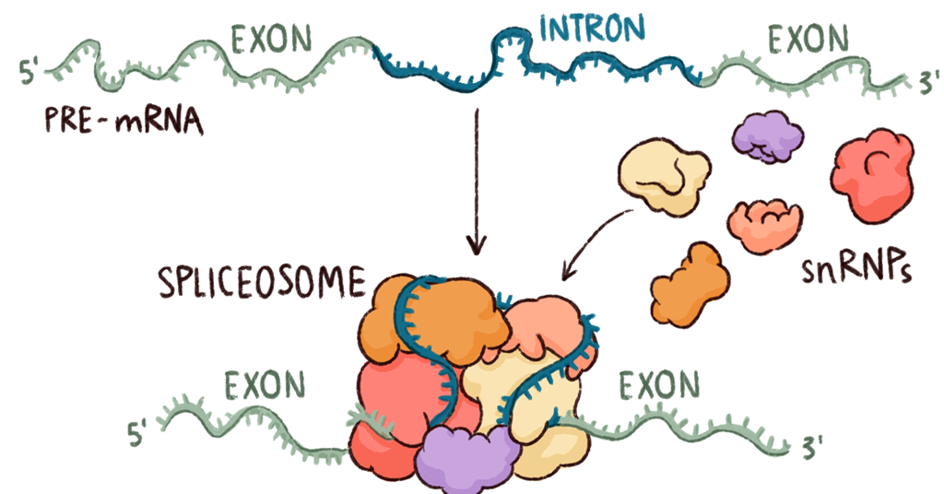
Core Concepts
Genes ➜ Transcripts

Slide 5
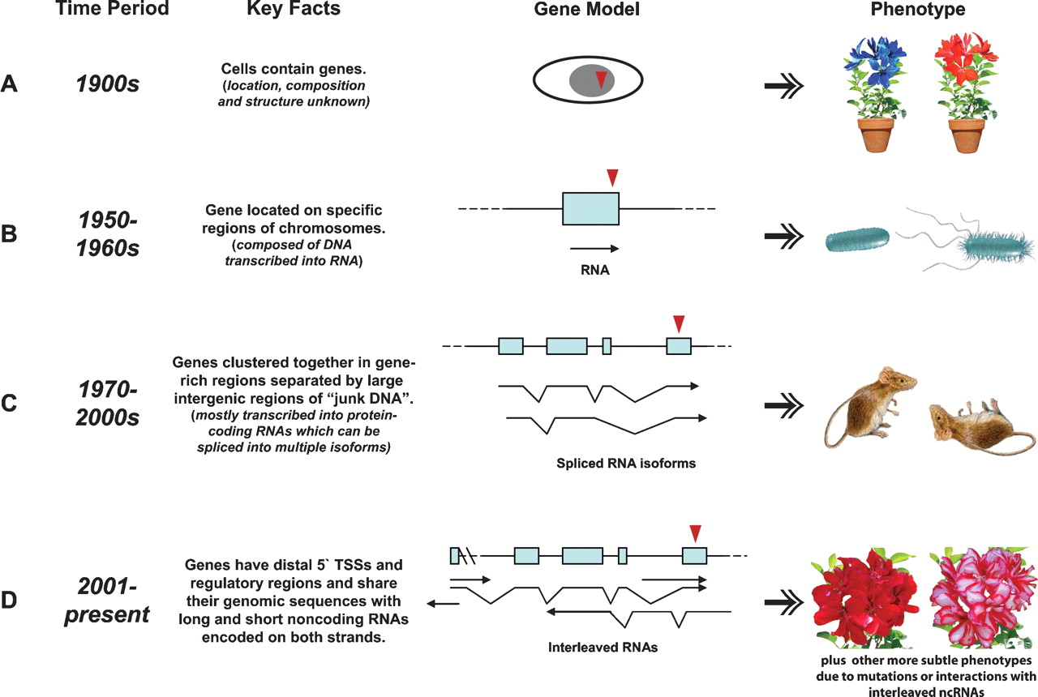
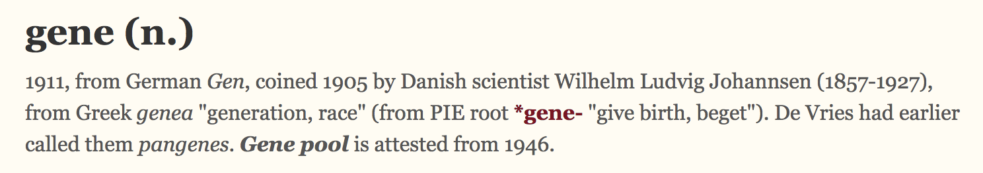
The Evolution of “Genes”
10.1101/gr.6525007

Slide 6
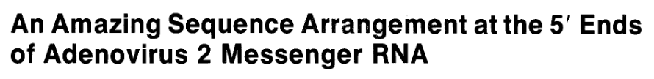
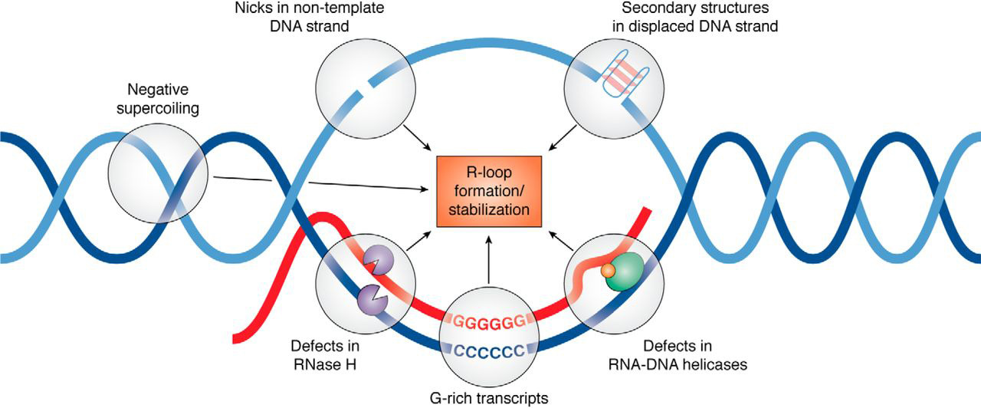
Alternative Splicing - 1977
10.1016/0092-8674(77)90180-5

Slide 7
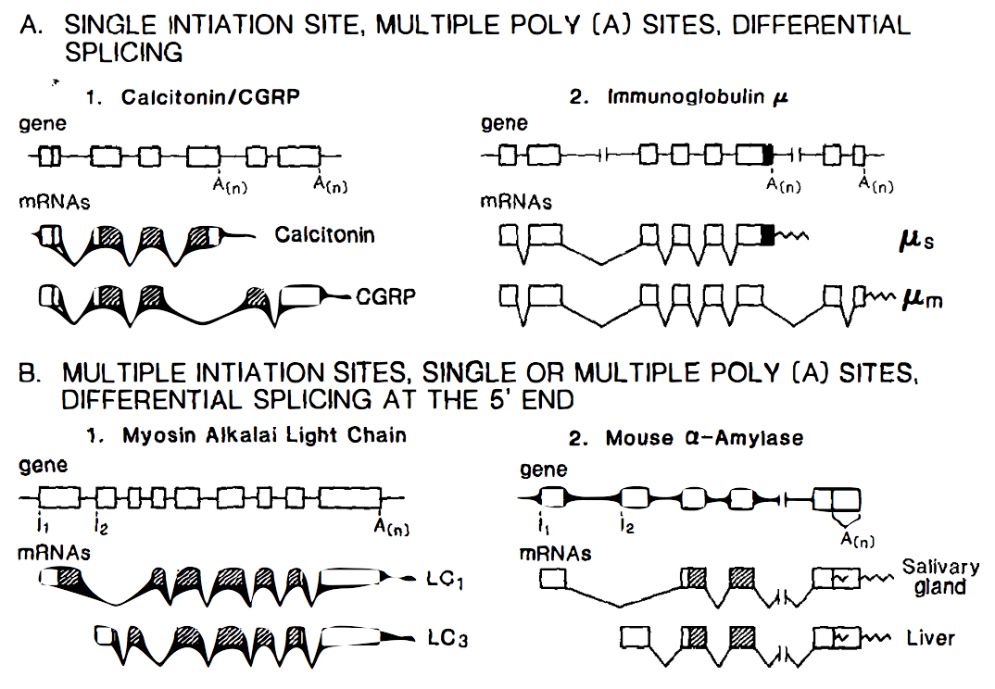
Alternative Splicing - 1981
10.1146/annurev.bi.55.070186.005303

Slide 8
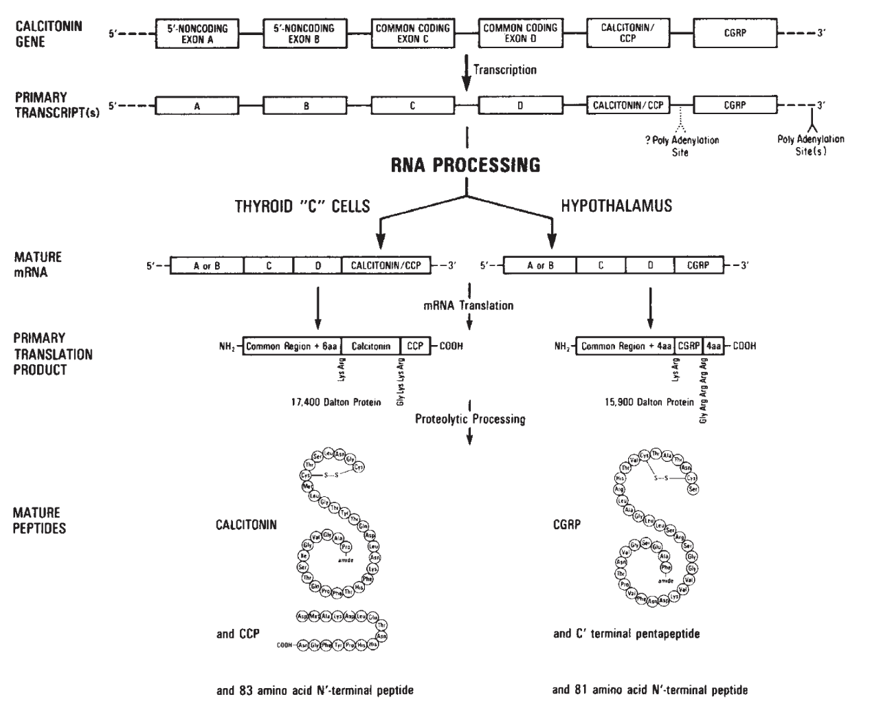
Alternative Splicing - 1981
10.1038/298240a0

Slide 9
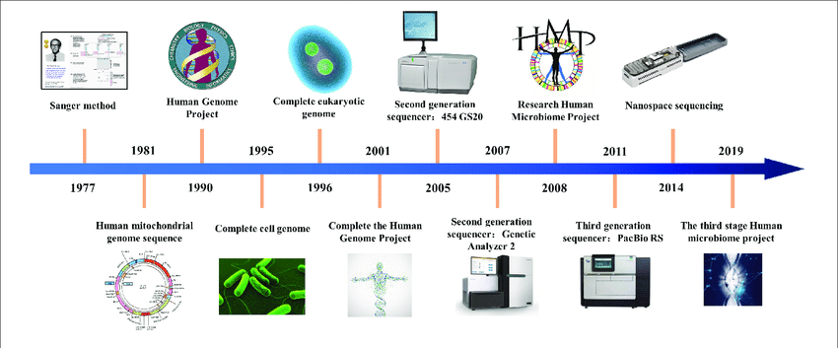
Sequencing
Changing the Game
10.3389/fbioe.2020.01032

Slide 10
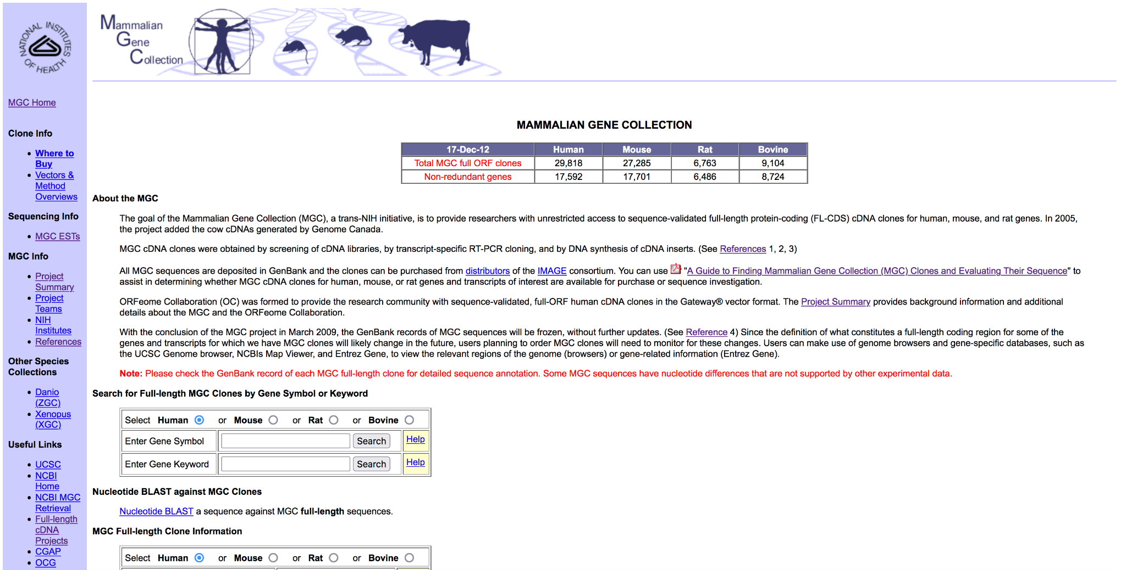
Mammalian Gene Collection

Slide 11
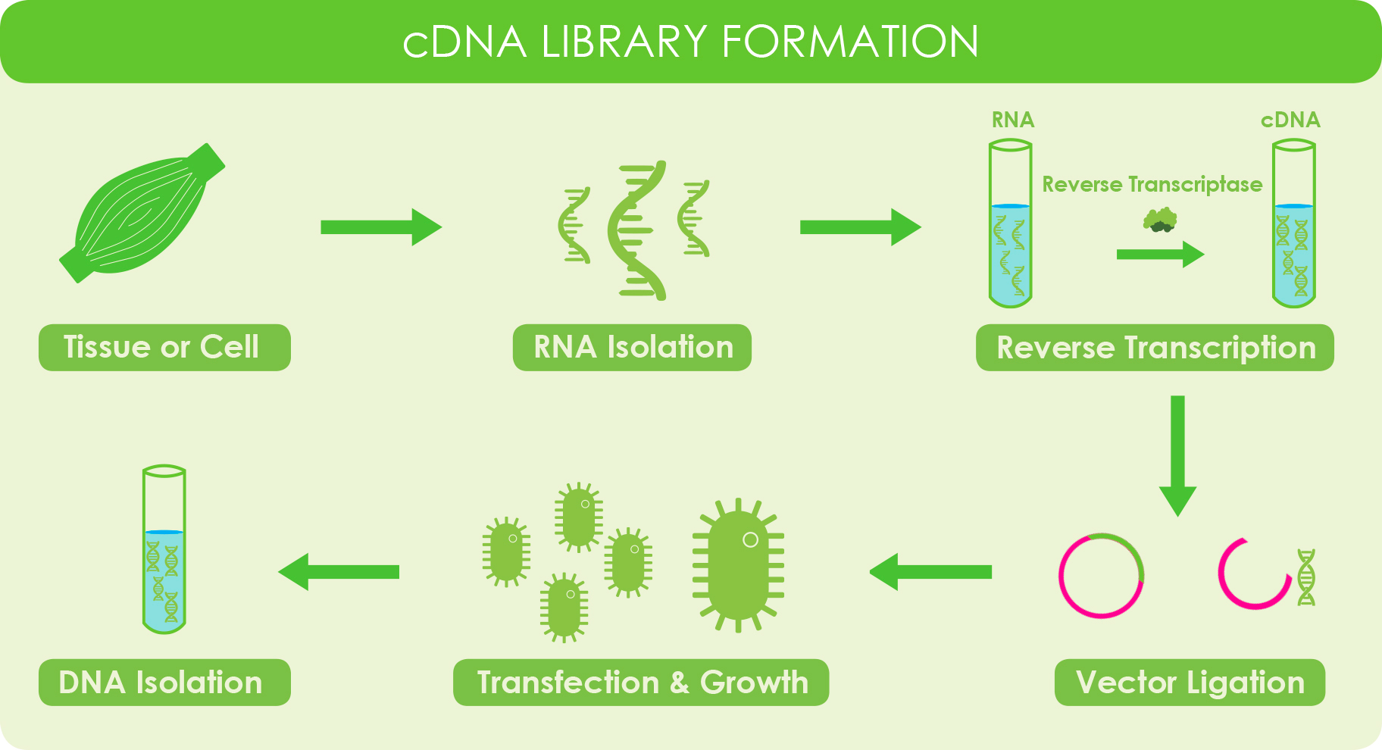
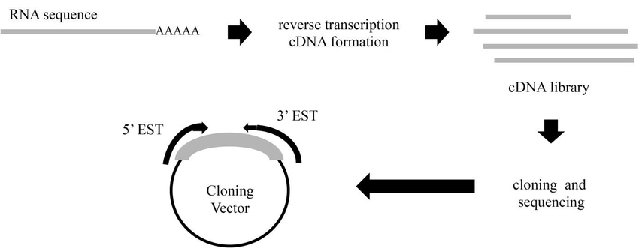
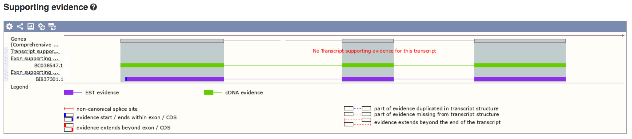
Clone Collection

Slide 12
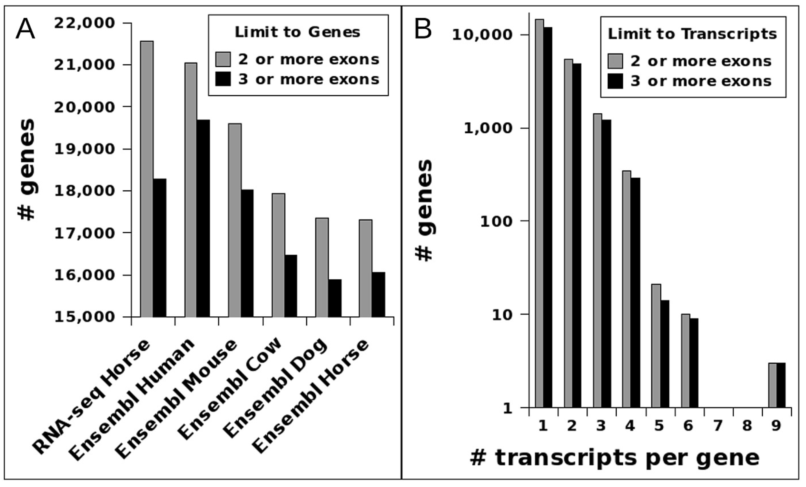
RNA Sequencing
10.1371/journal.pone.0124375.g002

Slide 13
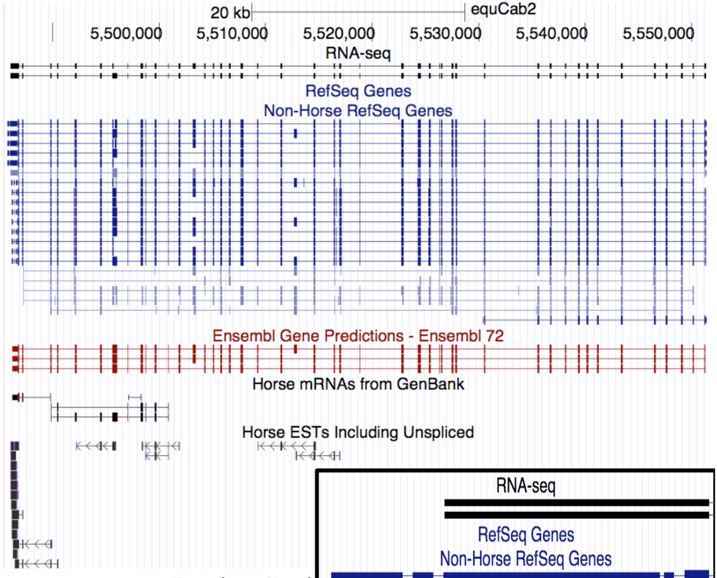
RNA Sequencing
FN1
10.1371/journal.pone.0124375.g002

Slide 14
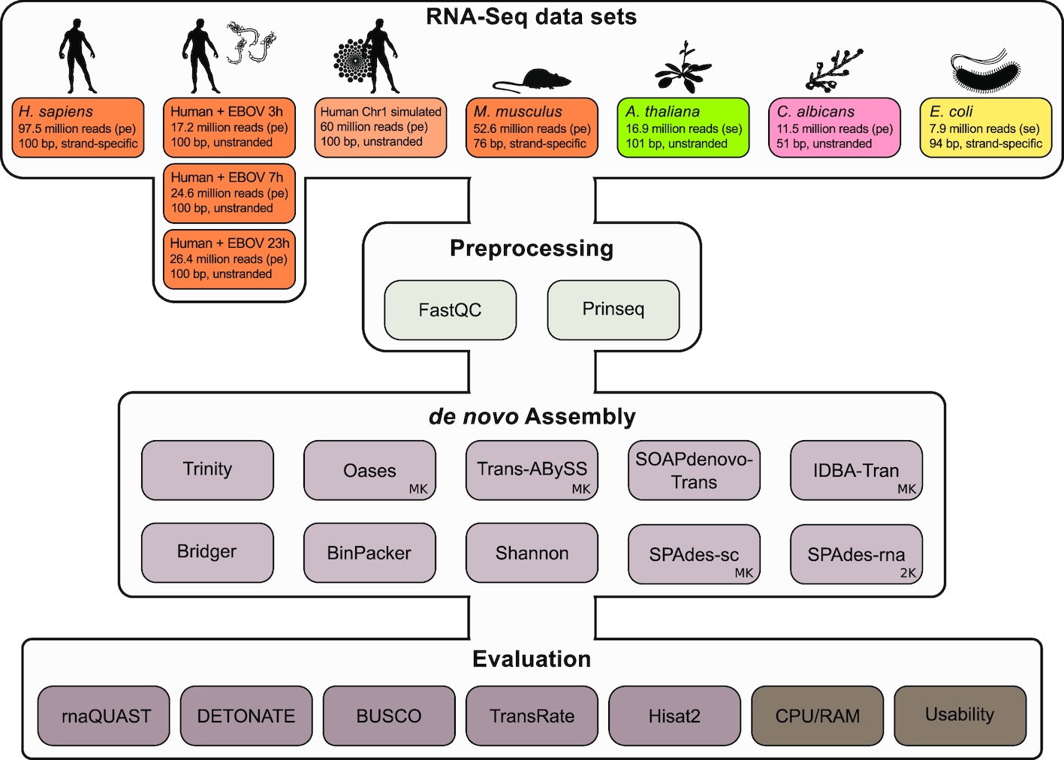
De Novo Assembly
10.1093/gigascience/giz039

Slide 15
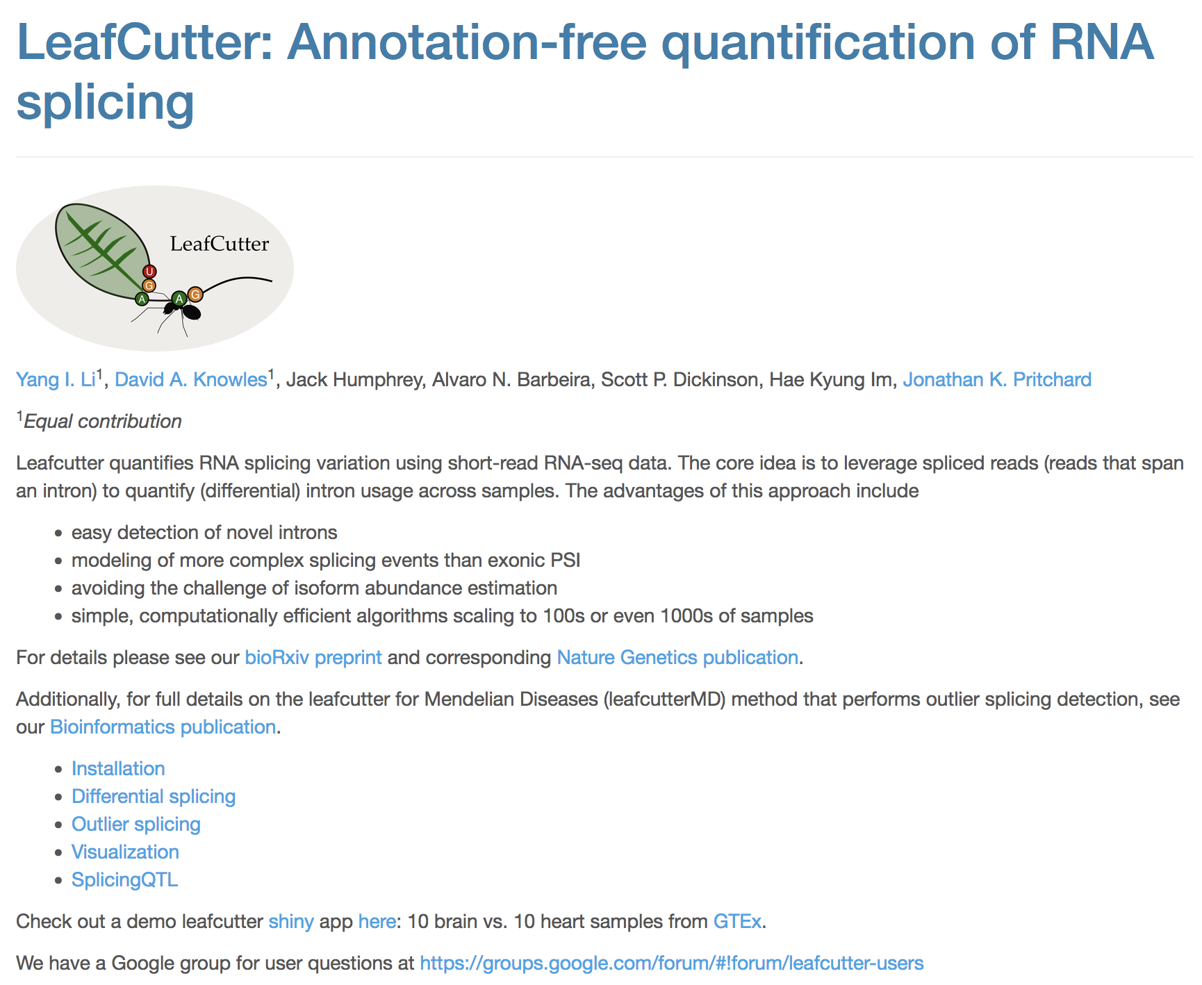
LeafCutter

Slide 16
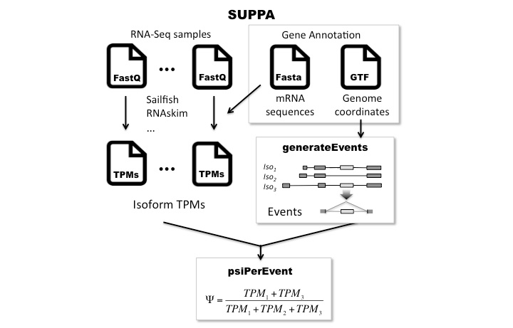
SUPPA2

Slide 17
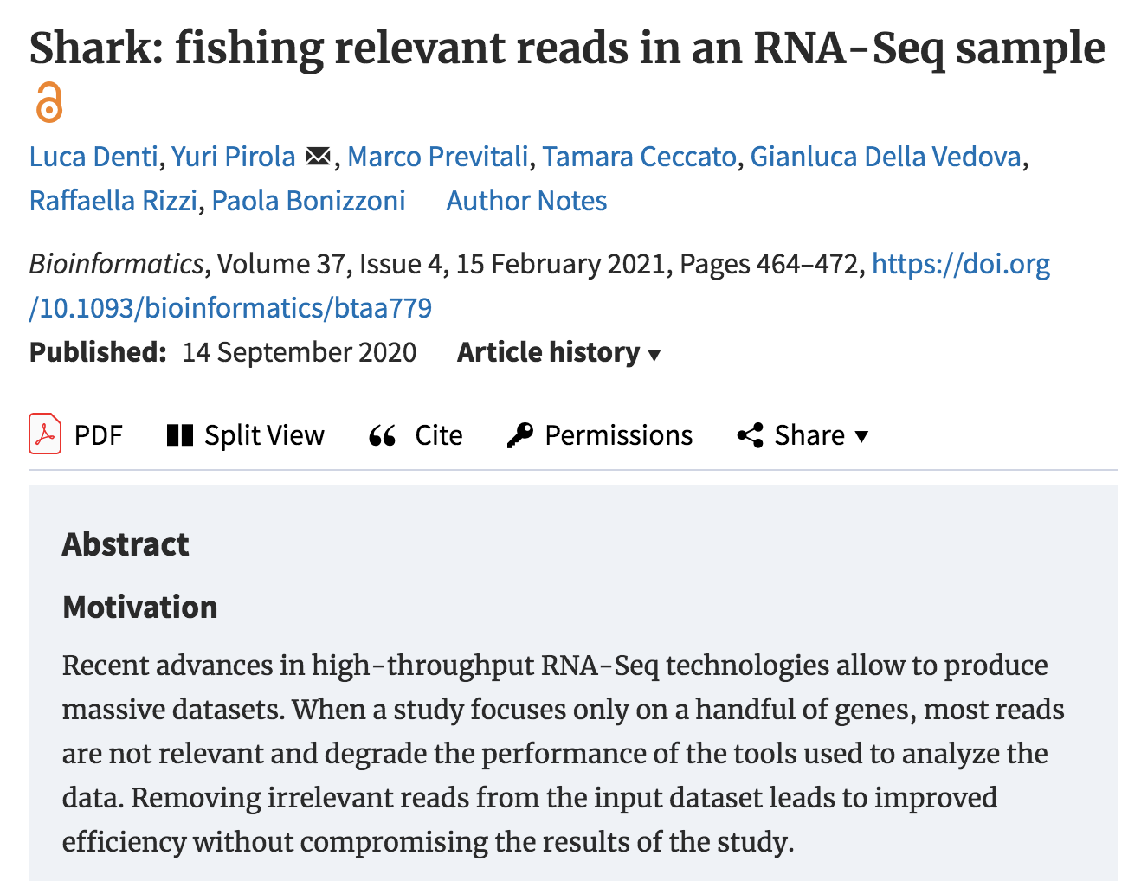
Shark

Slide 18
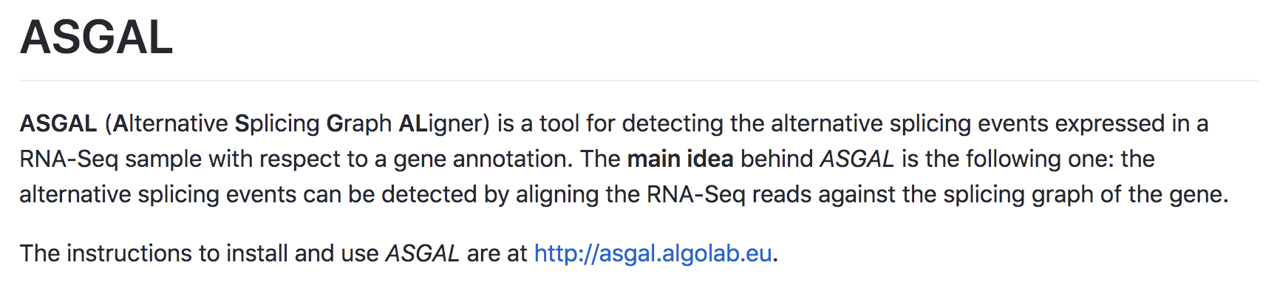
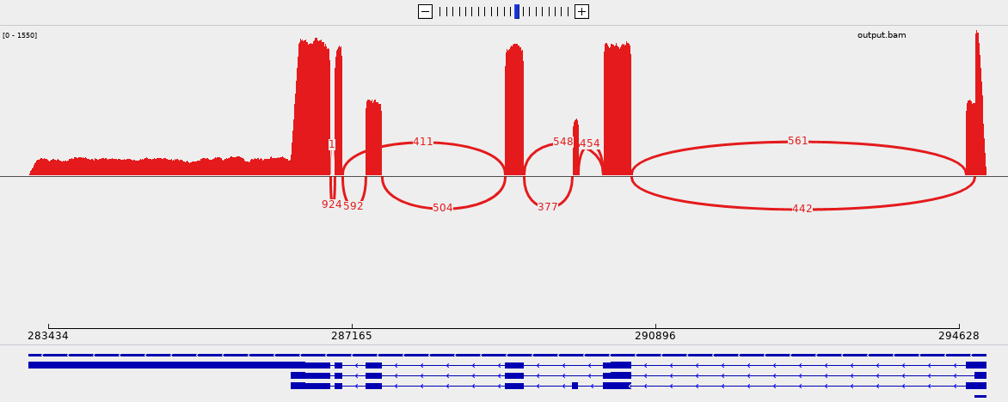
Bioinformatics Approaches
https://asgal.algolab.eu/documentation
SUPPA2
LeafCutter
IsoformSwitchAnalyzeR
DiffSplice
Shark
EventPointer
ASGAL
FRASER
Novel splicing event – Fruit Fly Example

Slide 19
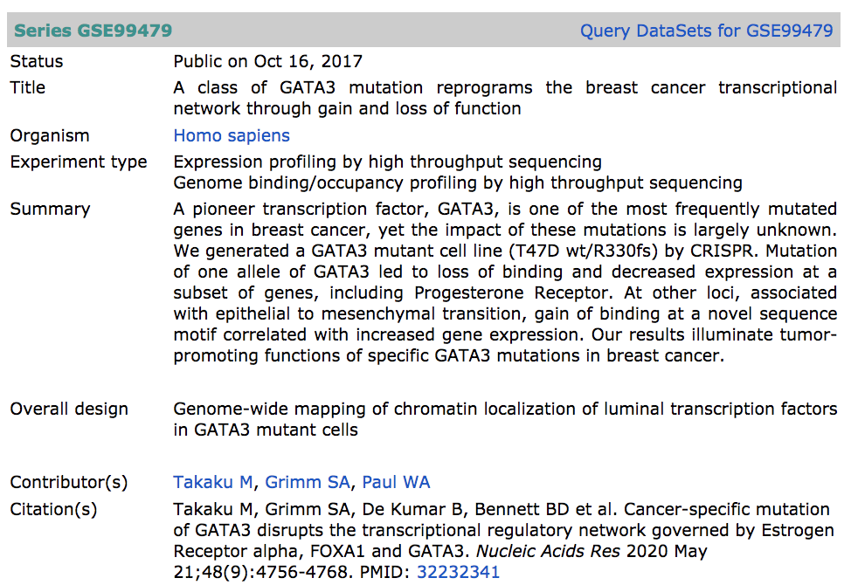
Example ASGAL Run
T47D wt/R330fsl tumors
10 weeks
SRR5929949
Implementation
Processes
Results

